Slide 1
“Detection of two rare network attacks (U2R) and (R2L)”

Slide 2
Related works to detect these attacks

Slide 3
A New Dependency and Correlation Analysis for Features -by Guangzhi,Salim ,Mazin Yousif.
What’s new?
a new feature correlation metric
feature subset merit measure
Consideration :
dependency among the features,
dependency with respect to a given data mining task
Removing data redundancy.

Slide 4
Validation:
DARPA KDD99 benchmark data set.
Detection rate:
U2R : 92.5%
false alarm : 0.7587%.
R2L : 92.47%
false alarm : 8.35%

Slide 5
Applying Neural Network to U2R Attacks
Proposed Model : Feedforward neural network
three layers connected with synapses
Training NN : Backpropagation algorithm
Dataset : Kddcup consists of U2R intrusive packets.
Performance:
Dataset | True positive | True negative | False positive | False negative
Training | 100 | 98.36 | 0.0 | 1.64
Testing | 95.45 | 100 | 4.55 | 0.0

Slide 6
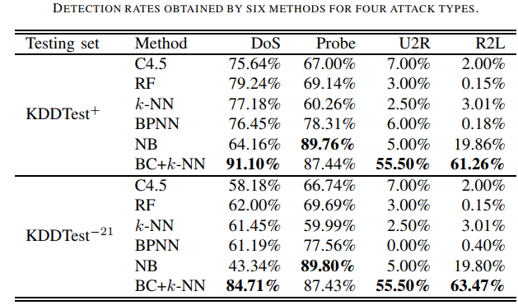
An effective two-step intrusion detection approach based on binary classification and k-NN
Two-step hybrid intrusion detection
Based on Binary classification, k-nearest neighbors

Slide 7
Intrusion Detection Model Based on Ensemble Learning for U2R and R2L Attacks
Ensemble Learning
combines multiple learners
improves accuracy of classifiers.
Adaboost Methods
adaptive boosting algorithm
Constructs a strong classifier as linear combination of weak classifiers.
Naïve Bayes
probability method based Bayes theorem

Slide 8
Multilayer Perceptron (MLP)
On of the artificial neural networks
Performs linear mapping
from input space to hidden space
From hidden space to output space
Other methods :
Decision Tree
Support Vector Machine (SVM)
k –Nearest Neighbor (k-NN)
Dataset : KDD Cup’99 dataset

Slide 9
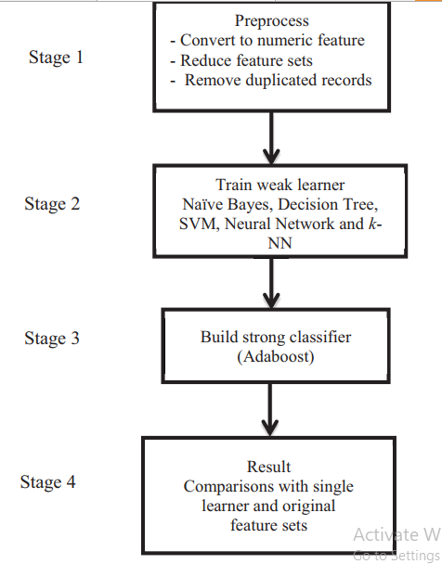
Implementation Model.

Slide 10
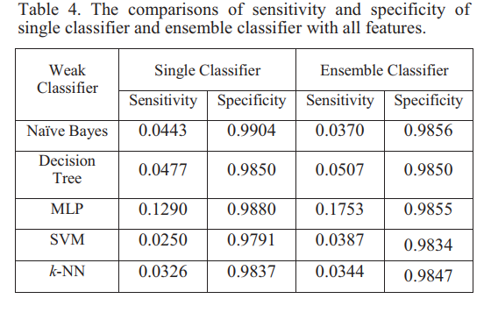
EXPERIMENTAL RESULT

Slide 11
Conclusion:
U2R and L2R are two rare attacks
Single method may not enough to detect them properly
Hybrid methods with higher success rate.

